Slide 1
Presented by Denise Peppers
Why does ?
Columbus Regional Mathematics Collaborative, Director

Slide 2
Our History
Established in November, 1989
Dr. Mary Lindquist, Former President of NCTM & Helen Purks Collins
Original funding—Ford Foundation matching grant
Originally 11 urban Math Collaboratives
Cleveland, OH
Minneapolis/St. Paul, MN
San Francisco, CA
Philadelphia, PA
Los Angeles, CA
St. Louis, MO
Durham, NC
Memphis, TN
San Diego, CA
Pittsburgh, PA
New Orleans, LA
Replication Sites
Columbus, GA
Dayton, OH
Worcester, MA
Milwaukee, WI
New York, NY

Slide 3
Our Mission
The mission of the Columbus Regional Mathematics Collaborative is to enhance the mathematics education of P-16 students through the development of teacher leaders, beginning with initial preparation and continuing through their professional teaching careers.

Slide 4
Goals
Enhance the preparation of prospective mathematics teachers at CSU.
Develop teacher leaders using the most current mathematics education research and best practices for classroom instruction.
Foster the teaching and learning of meaningful mathematics for all students, grades P-16.
Facilitate collaboration between the University and local education agencies, colleges within the University, and the community.

Slide 5
Current Staff
Elementary resource teachers
Cynthia Hill
Barbara Rouse
Monique Gunnels
Middle grades resource teacher
Hope Phillips
High school resource teacher
Nancy Mims
Administrative Assistant
Janet Knight
Director
Denise Peppers

Slide 6
Contact Info
http://crmc.columbusstate.edu/index.php
Peppers_denise@columbusstate.edu
Ph: 706-568-2480
FAX: 706-562-1477

Slide 7
Create the number 1111 in Base 10, Base 5, Base 4, & Base 3

Slide 8
Notice that…
…regardless of the base, the physical models in the columns are alike. That is, the progression is cube, rod, flat.

Slide 9
The word base…
Is very important here. It means we are working with exponents (or powers).
The base indicates the number of cubes, rods, or flats needed to change from one form to the next. That is, in base 3, 3 unit cubes are needed to make a rod; 3 rods are needed to make a flat; and so on. Basically, we are modeling exponential growth.

Slide 10
Exponential Growth
Let’s relate that back to our 1111 numbers.

Slide 11
Notice that…
The each rod represents the first power of the base; each flat represents the second power of the base; each larger cube represents the third power of the base.
The rods are all different “lengths;” the flats are all different “areas;” and the larger cubes are all different “volumes.” (Length, area, and volume are in quotation marks because I am not being literal; I am being figurative.)
The only physical representation that is the exact same is the unit cube. Regardless of the base, the unit cube is the same in every 1111 number.
Why? In order to build the first power of any base, we must begin with 1 unit cube and build upon it.

Slide 12
What do the base and exponent communicate?
The base communicates when you have reached the target point of growth. For a base of 3, we need 3 to “regroup.” For a base of 4, we need 4 to “regroup.” And so on.
The exponent communicates how many times we have “regrouped.”

Slide 13
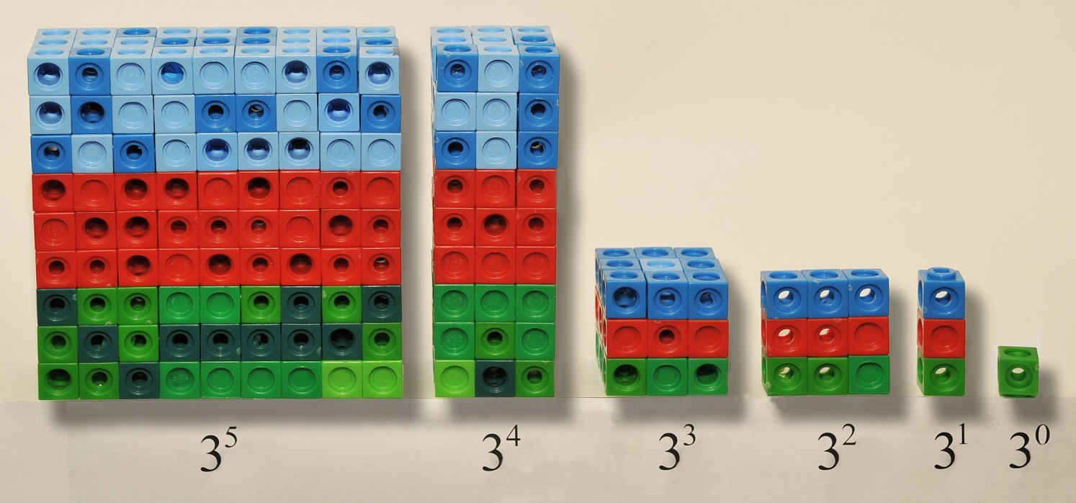
Can we build a representation for the 4th power or higher?
Based on our previous work, we can. For example, in base 3, I “regrouped” when I had 3 of the current model. That is, 3 unit cubes is a rod; 3 rods is a flat; 3 flats is a larger cube.
It stands to reason that the next progression is to have 3 larger cubes to make a larger rod; 3 larger rods to make a larger flat; and so on.

Slide 14
Notice that…
Even beyond the 3rd power, the progression continues: cube, rod, flat, cube, rod, flat,…
However, the physical models will be larger cubes, larger rods, and larger flats as the exponents increase.

Slide 15
So why does ?
Regardless of the base, in order to build, we must begin with 1 unit cube.
The base communicates when it is time to “regroup.” So writing a base to the zero power is necessary because, otherwise, there is a failure to communicate at what point to regroup.

Slide 16
Exponential City
Idea was developed as a result of professional development activity with teachers, including PE, art, music, and counselor
New Mountain Hill Elementary School, Harris County, GA
Instruction during art class on place value and exponential notation
Project presentation at evening dinner event

Slide 17
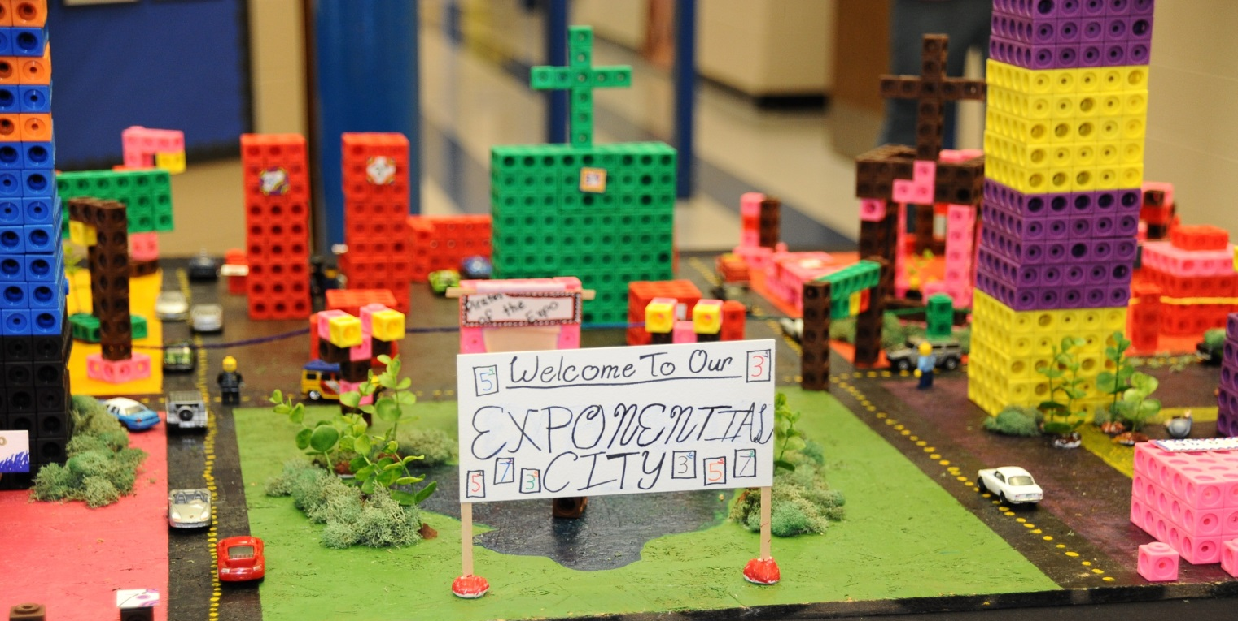
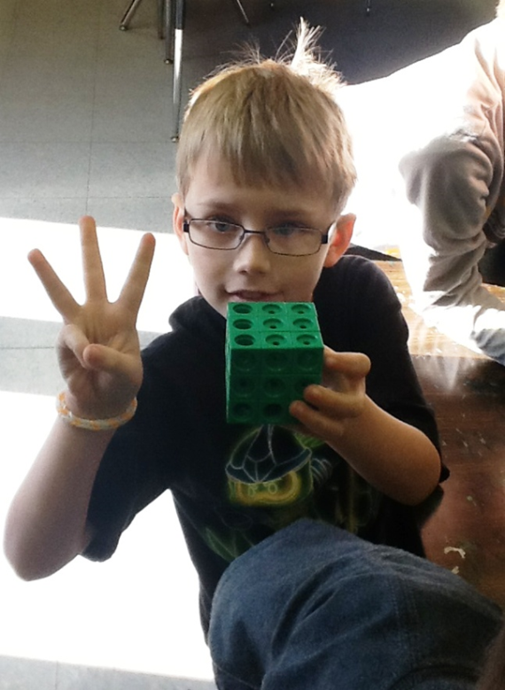
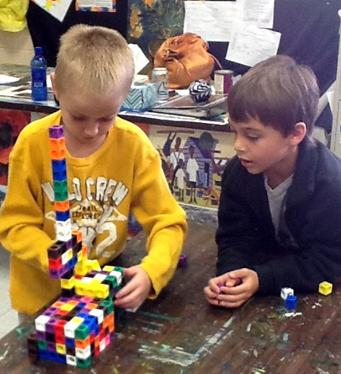
Pictures of the building process

Slide 18
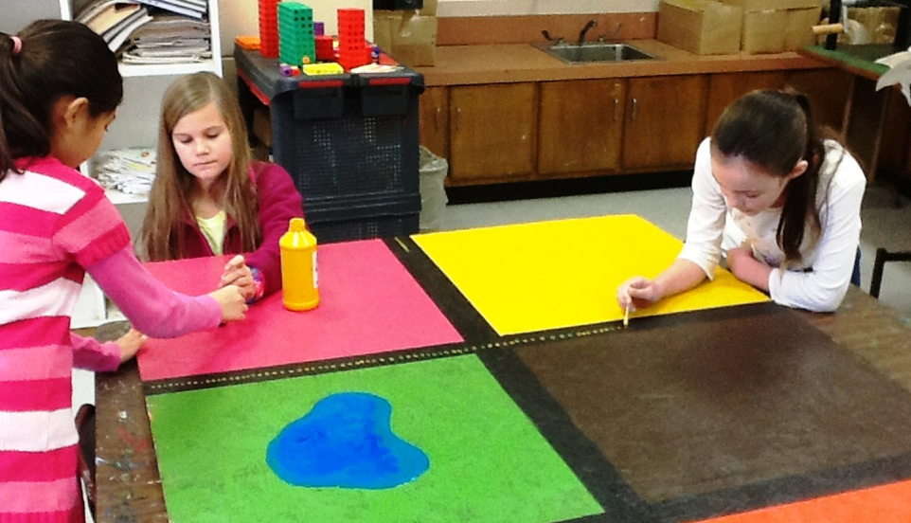
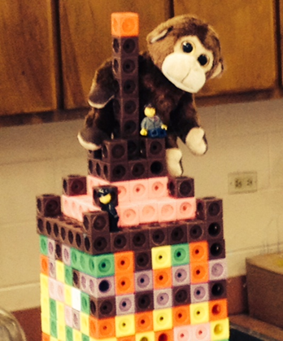
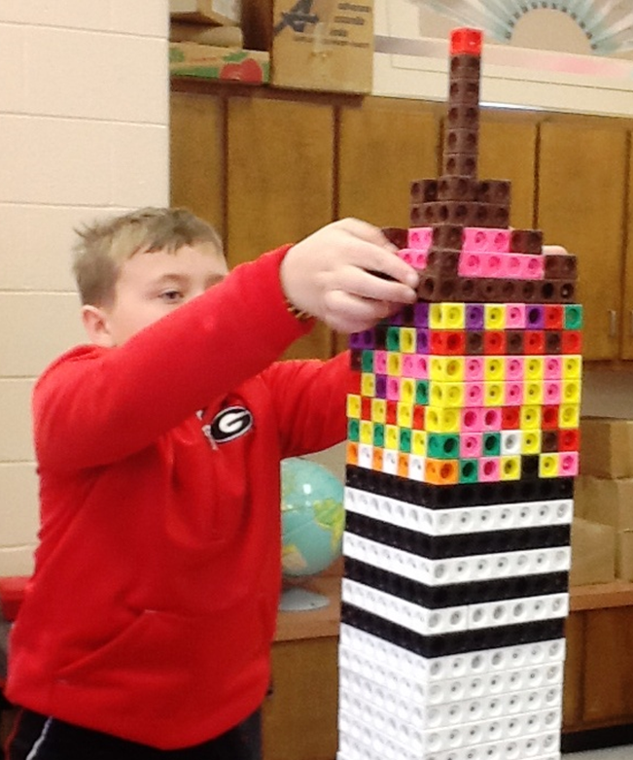
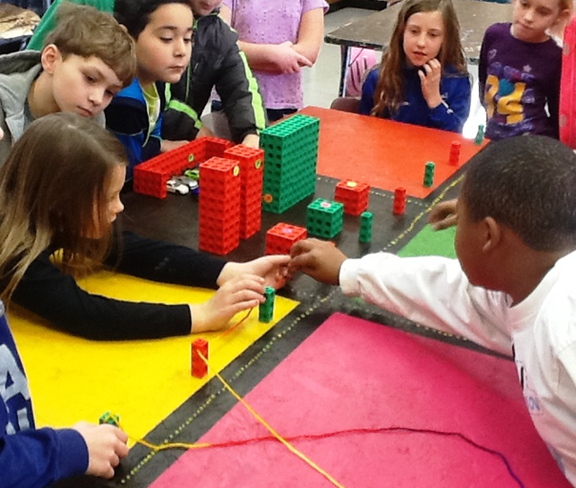

Slide 19
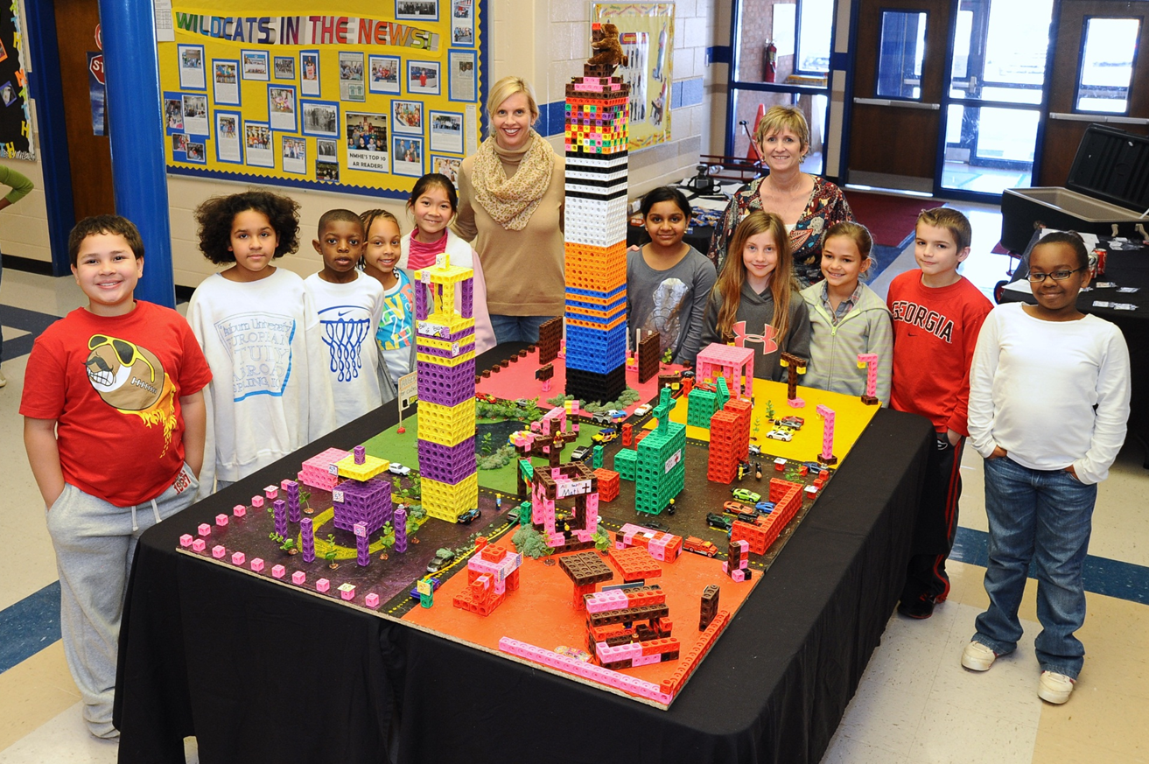
STEAM day presentation Science, Technology, Engineering, Art, & Math

Slide 20
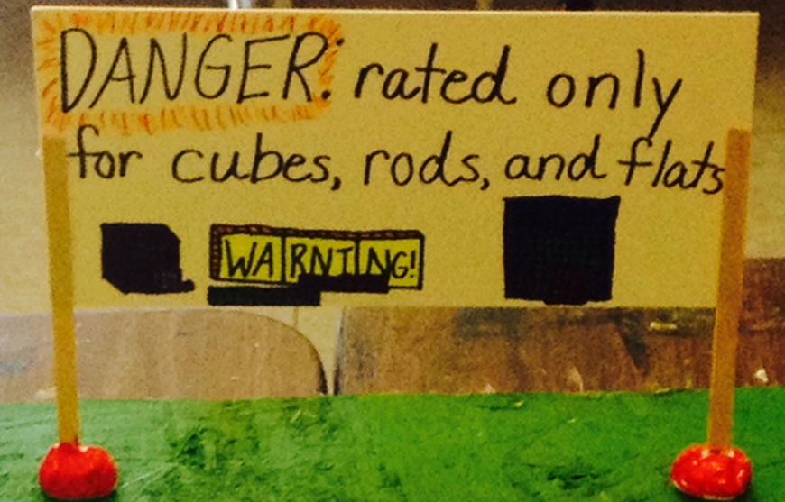
The students learned that any place in our numbering system can be expressed as a cube, rod, or flat regardless of how big the exponent is.

Slide 21
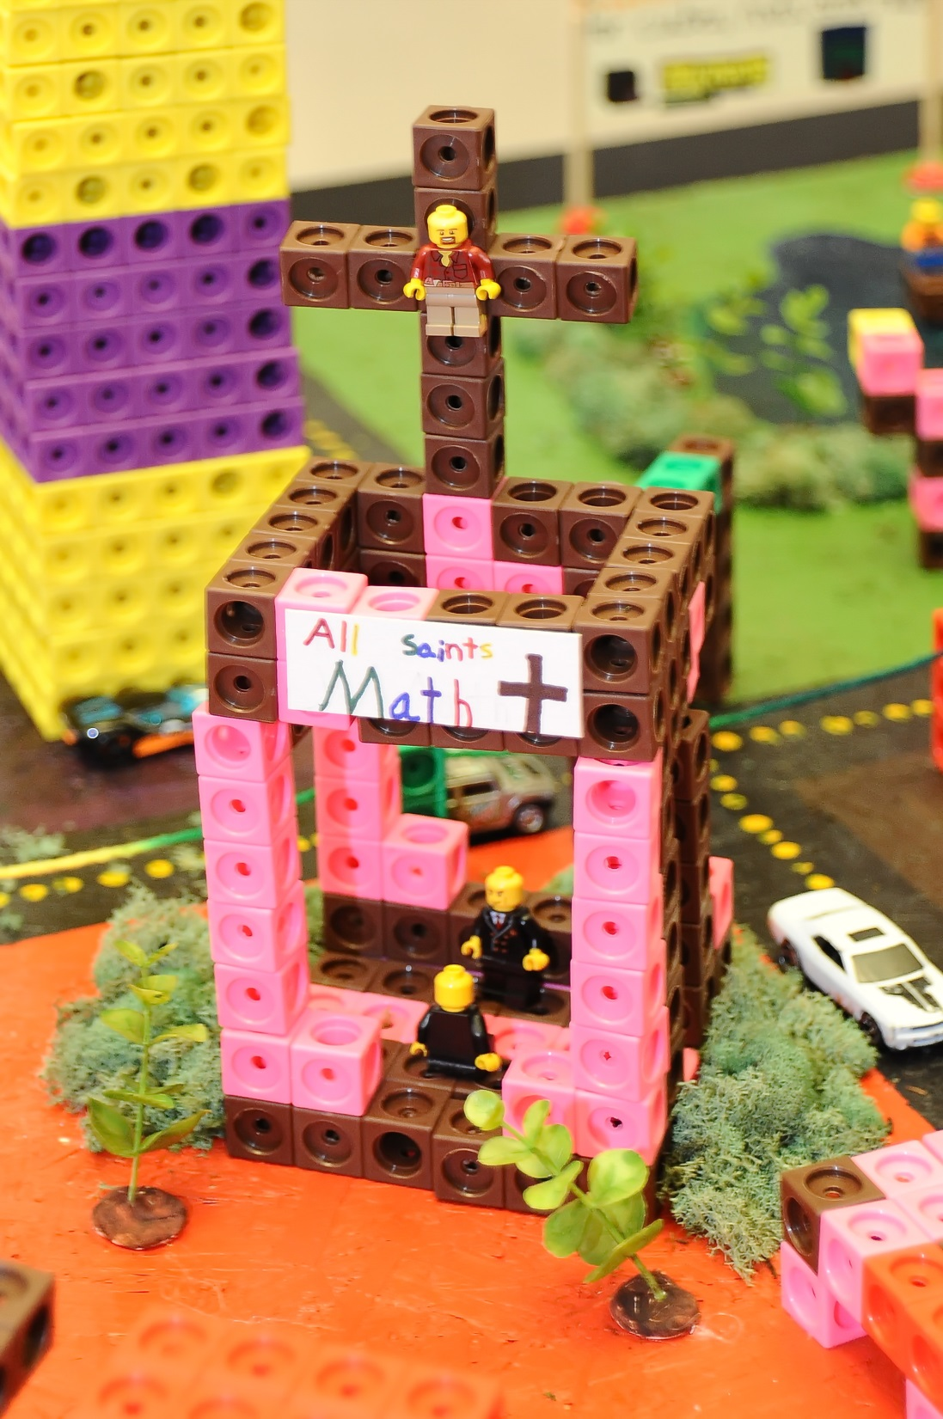
The students wanted to express their faith by having a church in their city, complete with Lego Jesus on the cross.

Slide 22
King Kong is high atop the Exponent State Building terrorizing the city.

Slide 23
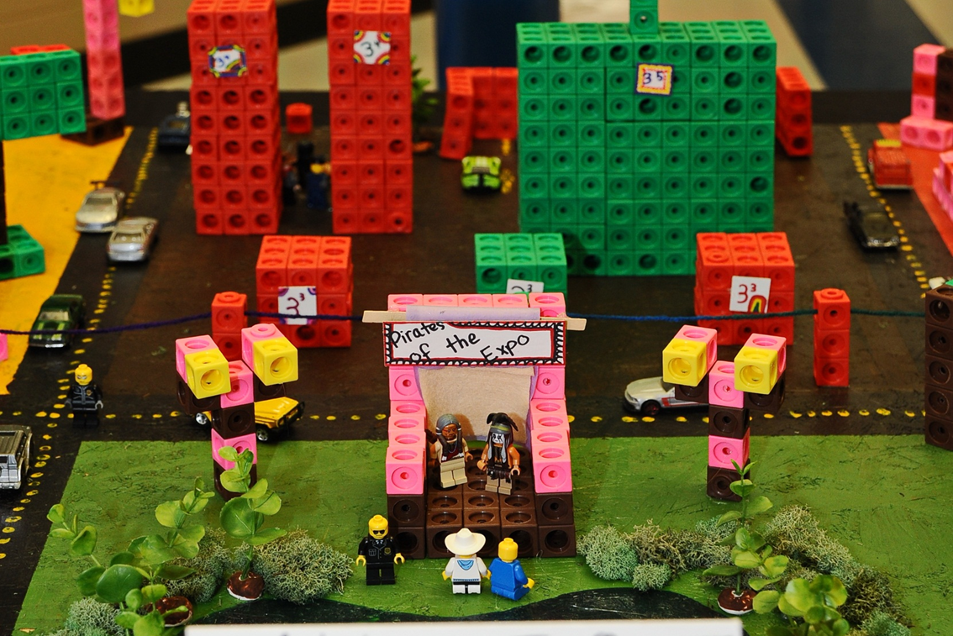
Johnny Depp would have been proud

Slide 24
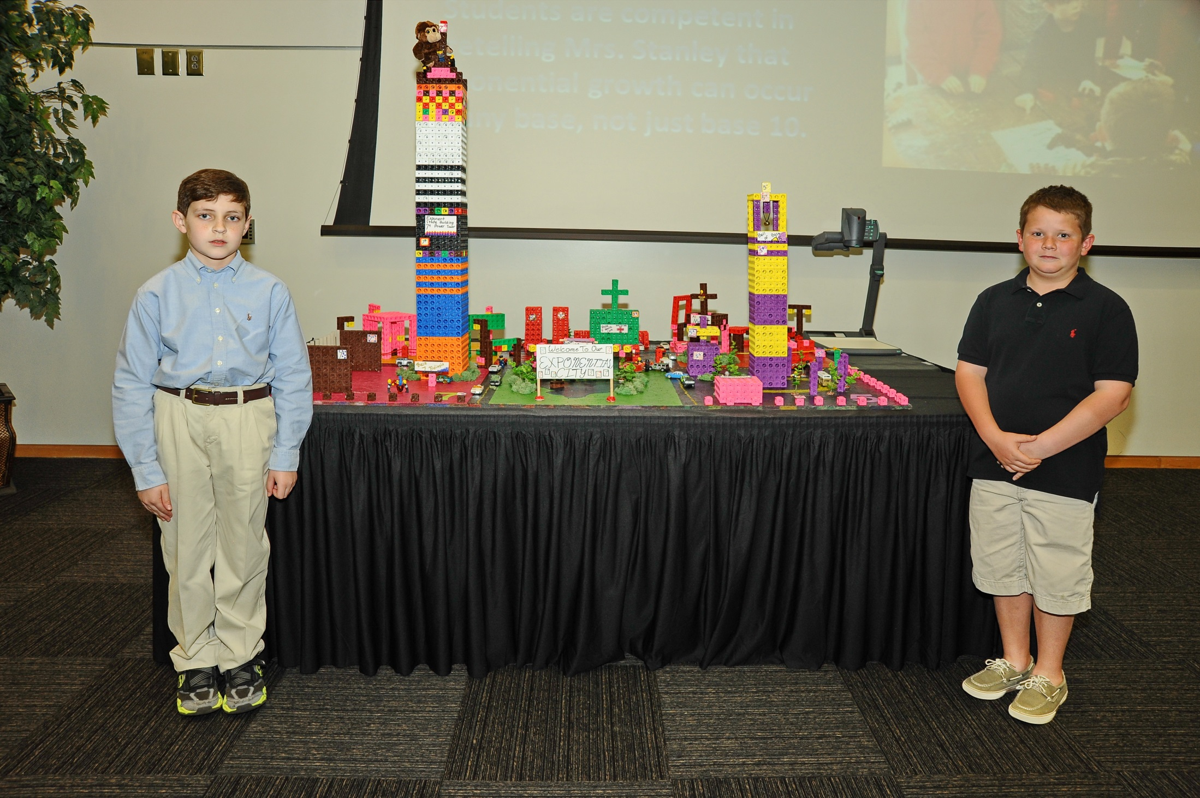
CRMC evening event

Slide 25
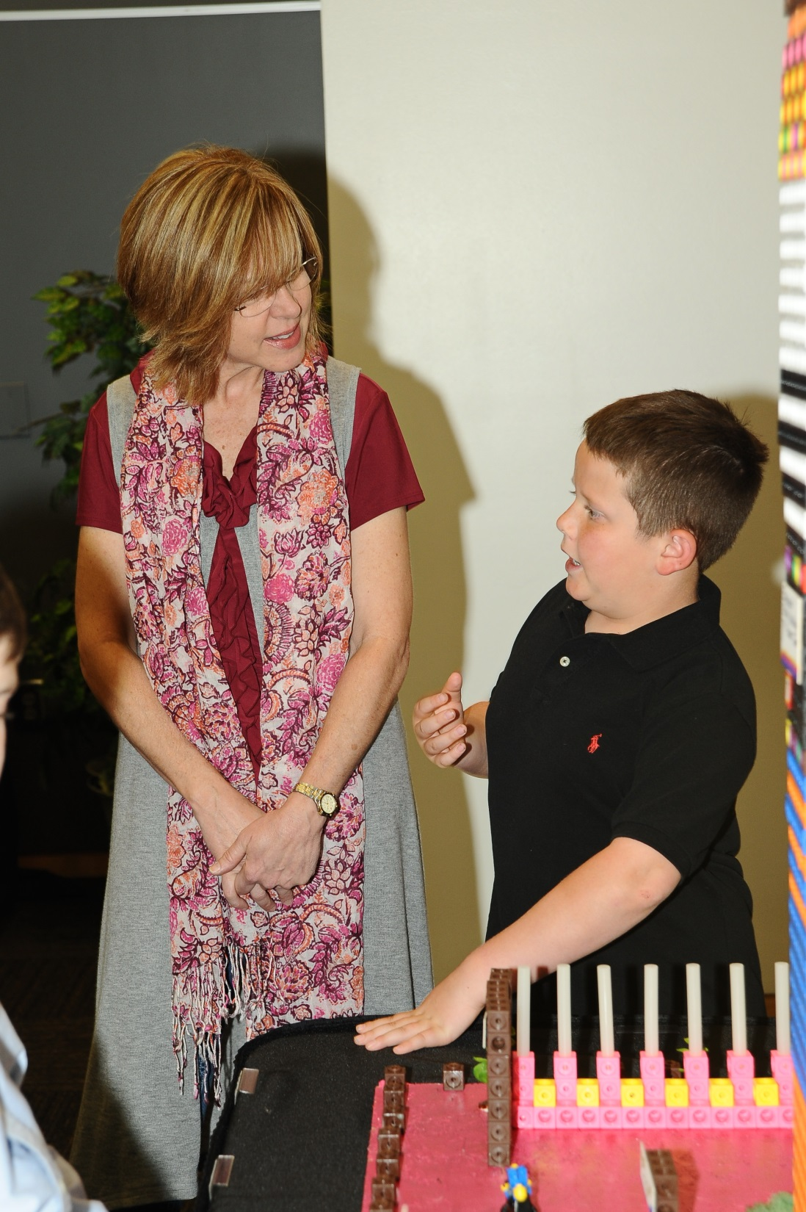
Tanner explains the Bellagio Fountain made out of glue sticks.

Slide 26
The “Bell of Base 5”

Slide 27
